Slide 1
Complete the Trace for the Following Datalog Program
And show the TA where in your code the different steps are performed

Slide 2
A Complete Datalog Program
Schemes:
A(C)
B(D)
Facts:
A(‘1’)
Rules:
Queries:
A(b1)?

Slide 3
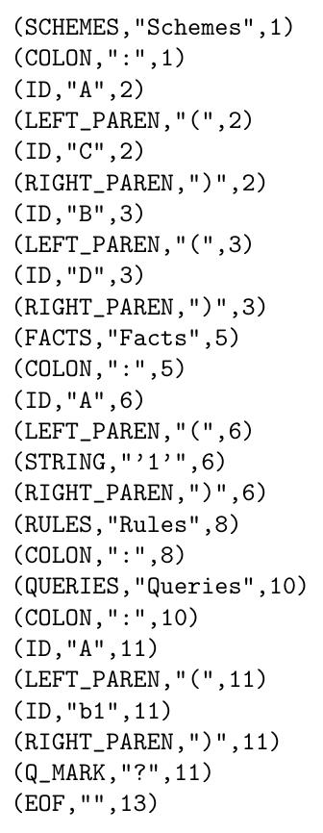
A Complete Datalog Program
Schemes:
A(C)
B(D)
Facts:
A(‘1’)
Rules:
Queries:
A(b1)?
This is the
input stream

Slide 4
A Complete Datalog Program
Schemes:
A(C)
B(D)
Facts:
A(‘1’)
Rules:
Queries:
A(b1)?
End your
trace here

Slide 5
Trace
Stack
Input
Datalog()

Slide 6
Trace
Stack
Input
Datalog()

Slide 7
Trace
Stack
Input
Datalog()
scheme()

Slide 8
Trace
Stack
Input
Datalog()
scheme()

Slide 9
Trace
Stack
Input
Datalog()
scheme()

Slide 10
Trace
Stack
Input
Datalog()
scheme()

Slide 11
Trace
Stack
Input
Datalog()
scheme()
idList()

Slide 12
Trace
Stack
Input
Datalog()
scheme()
idList()

Slide 13
Trace
Stack
Input
Datalog()
scheme()

Slide 14
Trace
Stack
Input
Datalog()

Slide 15
Trace
Stack
Input
Datalog()
schemeList()

Slide 16
Trace
Stack
Input
Datalog()
schemeList()

Slide 17
Trace
Stack
Input
Datalog()
schemeList()

Slide 18
Trace
Stack
Input
Datalog()
schemeList()

Slide 19
Trace
Stack
Input
Datalog()
schemeList()

Slide 20
Trace
Stack
Input
Datalog()
schemeList()
idList()

Slide 21
Trace
Stack
Input
Datalog()
schemeList()
idList()

Slide 22
Trace
Stack
Input
Datalog()
schemeList()

Slide 23
Trace
Stack
Input
Datalog()
schemeList()

Slide 24
Trace
Stack
Input
Datalog()

Slide 25
Trace
Stack
Input
Datalog()

Slide 26
Trace
Stack
Input
Datalog()
factList()

Slide 27
Trace
Stack
Input
Datalog()
factList()
fact()

Slide 28
Trace
Stack
Input
Datalog()
factList()
fact()

Slide 29
Trace
Stack
Input
Datalog()
factList()
fact()

Slide 30
Trace
Stack
Input
Datalog()
factList()
fact()

Slide 31
Trace
Stack
Input
Datalog()
factList()
fact()
stringList()

Slide 32
Trace
Stack
Input
Datalog()
factList()
fact()
stringList()

Slide 33
Trace
Stack
Input
Datalog()
factList()
fact()

Slide 34
Trace
Stack
Input
Datalog()
factList()
fact()
**Error, no period. Trace ends**

